Slide 1
Data Mining: Concepts and Techniques Data Preprocessing
主讲教师: 王灿, wcan@zju.edu.cn
TA: 陈德仿, defchern@zju.edu.cn

Slide 2
Chapter 3: Data Preprocessing
Data Preprocessing: An Overview
Data Quality
Major Tasks in Data Preprocessing
Data Cleaning
Data Integration
Data Reduction
Data Transformation and Data Discretization
Summary
2

Slide 3
Data Quality: Why Preprocess the Data?
Measures for data quality: A multidimensional view
Accuracy: correct or wrong, accurate or not
Completeness: not recorded, unavailable, …
Consistency: some modified but some not, dangling, …
Timeliness: timely update?
Believability: how trustable the data are correct?
Interpretability: how easily the data can be understood?

Slide 4
Major Tasks in Data Preprocessing
Data cleaning
Fill in missing values, smooth noisy data, identify or remove outliers, and resolve inconsistencies
Data integration
Integration of multiple databases, data cubes, or files
Data reduction
Dimensionality reduction
Numerosity reduction
Data compression
Data transformation and data discretization
Normalization
Concept hierarchy generation

Slide 5
Chapter 3: Data Preprocessing
Data Preprocessing: An Overview
Data Quality
Major Tasks in Data Preprocessing
Data Cleaning
Data Integration
Data Reduction
Data Transformation and Data Discretization
Summary
5

Slide 6
Data Cleaning
Data in the Real World Is Dirty: Lots of potentially incorrect data, e.g., instrument faulty, human or computer error, transmission error
incomplete: lacking attribute values, lacking certain attributes of interest, or containing only aggregate data
e.g., Occupation=“ ” (missing data)
noisy: containing noise, errors, or outliers
e.g., Salary=“−10” (an error)
inconsistent: containing discrepancies in codes or names, e.g.,
Age=“42”, Birthday=“03/07/2010”
Was rating “1, 2, 3”, now rating “A, B, C”
discrepancy between duplicate records
Intentional (e.g., disguised missing data)
Jan. 1 as everyone’s birthday?

Slide 7
Incomplete (Missing) Data
Data is not always available
E.g., many tuples have no recorded value for several attributes, such as customer income in sales data
Missing data may be due to
equipment malfunction
inconsistent with other recorded data and thus deleted
data not entered due to misunderstanding
certain data may not be considered important at the time of entry
not register history or changes of the data
Missing data may need to be inferred

Slide 8
How to Handle Missing Data?
Ignore the tuple: usually done when class label is missing (when doing classification)—not effective when the % of missing values per attribute varies considerably
Fill in the missing value manually: tedious + infeasible?
Fill in it automatically with
a global constant : e.g., “unknown”, a new class?!
the attribute mean
the attribute mean for all samples belonging to the same class: smarter
the most probable value: inference-based such as Bayesian formula or decision tree

Slide 9
Noisy Data
Noise: random error or variance in a measured variable
Incorrect attribute values may be due to
faulty data collection instruments
data entry problems
data transmission problems
technology limitation
inconsistency in naming convention
Other data problems which require data cleaning
duplicate records
incomplete data
inconsistent data
9
Notes:
9

Slide 10
How to Handle Noisy Data?
Binning
first sort data and partition into (equal-frequency) bins
then one can smooth by bin means, smooth by bin median, smooth by bin boundaries, etc.
Regression
smooth by fitting the data into regression functions
Clustering
detect and remove outliers
Combined computer and human inspection
detect suspicious values and check by human (e.g., deal with possible outliers)

Slide 11
Data Cleaning as a Process
Data discrepancy detection
Use metadata (e.g., domain, range, dependency, distribution)
Check field overloading
Check uniqueness rule, consecutive rule and null rule
Use commercial tools
Data scrubbing: use simple domain knowledge (e.g., postal code, spell-check) to detect errors and make corrections
Data auditing: by analyzing data to discover rules and relationship to detect violators (e.g., correlation and clustering to find outliers)
Data migration and integration
Data migration tools: allow transformations to be specified
ETL (Extraction/Transformation/Loading) tools: allow users to specify transformations through a graphical user interface
Integration of the two processes
Iterative and interactive (e.g., Potter’s Wheels)

Slide 12
Chapter 3: Data Preprocessing
Data Preprocessing: An Overview
Data Quality
Major Tasks in Data Preprocessing
Data Cleaning
Data Integration
Data Reduction
Data Transformation and Data Discretization
Summary
12

Slide 13
Data Integration
Data integration:
Combines data from multiple sources into a coherent store
Schema integration: e.g., A.cust-id ≡ B.cust-#
Integrate metadata from different sources
Entity identification problem:
Identify real world entities from multiple data sources, e.g., Bill Clinton = William Clinton
Detecting and resolving data value conflicts
For the same real world entity, attribute values from different sources are different
Possible reasons: different representations, different scales, e.g., metric vs. British units
13

Slide 14
Handling Redundancy in Data Integration
Redundant data occur often when integration of multiple databases
Object identification: The same attribute or object may have different names in different databases
Derivable data: One attribute may be a “derived” attribute in another table, e.g., annual revenue
Redundant attributes may be able to be detected by correlation analysis and covariance analysis
Careful integration of the data from multiple sources may help reduce/avoid redundancies and inconsistencies and improve mining speed and quality
14

Slide 15
Correlation Analysis (Nominal Data)
Χ² (chi-square) test
The larger the Χ² value, the more likely the variables are related
The cells that contribute the most to the Χ² value are those whose actual count is very different from the expected count
Correlation does not imply causality
# of hospitals and # of car-theft in a city are correlated
Both are causally linked to the third variable: population

Slide 16
Chi-Square Calculation: An Example
Χ² (chi-square) calculation (numbers in parenthesis are expected counts calculated based on the data distribution in the two categories)
It shows that like_science_fiction and play_chess are correlated in the group
 | Play chess | Not play chess | Sum (row)
Like science fiction | 250(90) | 200(360) | 450
Not like science fiction | 50(210) | 1000(840) | 1050
Sum(col.) | 300 | 1200 | 1500

Slide 17
Correlation Analysis (Numeric Data)
Correlation coefficient (also called Pearson’s product moment coefficient)
where n is the number of tuples, and are the respective means of A and B, σ_{A} and σ_{B} are the respective standard deviation of A and B, and Σ(a_{i}b_{i}) is the sum of the AB cross-product.
If r_{A,B} > 0, A and B are positively correlated (A’s values increase as B’s). The higher, the stronger correlation.
r_{A,B} = 0: independent; r_{AB} < 0: negatively correlated

Slide 18
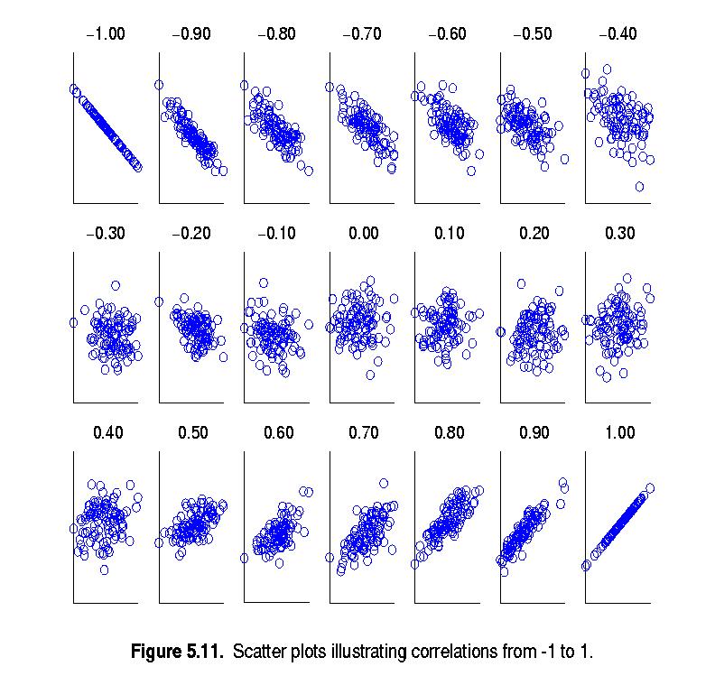
Visually Evaluating Correlation
Scatter plots showing the similarity from –1 to 1.

Slide 19
Correlation (viewed as linear relationship)
Correlation measures the linear relationship between objects
To compute correlation, we standardize data objects, A and B, and then take their dot product

Slide 20
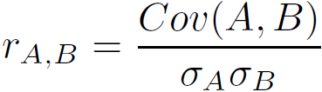
Covariance (Numeric Data)
Covariance is similar to correlation
where n is the number of tuples, and are the respective mean or expected values of A and B, σ_{A} and σ_{B} are the respective standard deviation of A and B.
Positive covariance: If Cov_{A,B} > 0, then A and B both tend to be larger than their expected values.
Negative covariance: If Cov_{A,B} < 0 then if A is larger than its expected value, B is likely to be smaller than its expected value.
Independence: Cov_{A,B} = 0 but the converse is not true:
Some pairs of random variables may have a covariance of 0 but are not independent. Only under some additional assumptions (e.g., the data follow multivariate normal distributions) does a covariance of 0 imply independence
Correlation coefficient:

Slide 21

Co-Variance: An Example
It can be simplified in computation as
Suppose two stocks A and B have the following values in one week: (2, 5), (3, 8), (5, 10), (4, 11), (6, 14).
Question: If the stocks are affected by the same industry trends, will their prices rise or fall together?
E(A) = (2 + 3 + 5 + 4 + 6)/ 5 = 20/5 = 4
E(B) = (5 + 8 + 10 + 11 + 14) /5 = 48/5 = 9.6
Cov(A,B) = (2×5+3×8+5×10+4×11+6×14)/5 − 4 × 9.6 = 4
Thus, A and B rise together since Cov(A, B) > 0.

Slide 22
Chapter 3: Data Preprocessing
Data Preprocessing: An Overview
Data Quality
Major Tasks in Data Preprocessing
Data Cleaning
Data Integration
Data Reduction
Data Transformation and Data Discretization
Summary
22
Notes:
22

Slide 23
Data Reduction Strategies
Data reduction: Obtain a reduced representation of the data set that is much smaller in volume but yet produces the same (or almost the same) analytical results
Why data reduction? — A database/data warehouse may store terabytes of data. Complex data analysis may take a very long time to run on the complete data set.
Data reduction strategies
Dimensionality reduction, e.g., remove unimportant attributes
Wavelet transforms
Principal Components Analysis (PCA)
Feature subset selection, feature creation
Numerosity reduction (some simply call it: Data Reduction)
Regression and Log-Linear Models
Histograms, clustering, sampling
Data cube aggregation
Data compression

Slide 24
Data Reduction 1: Dimensionality Reduction
Curse of dimensionality
When dimensionality increases, data becomes increasingly sparse
Density and distance between points, which is critical to clustering, outlier analysis, becomes less meaningful
The possible combinations of subspaces will grow exponentially
Dimensionality reduction
Avoid the curse of dimensionality
Help eliminate irrelevant features and reduce noise
Reduce time and space required in data mining
Allow easier visualization
Notes:
24

Slide 25
Dimensionality Reduction Algorithms
Unsupervised
Latent Semantic Indexing (LSI): truncated SVD
Principal Component Analysis (PCA)
Independent Component Analysis (ICA)
Canonical Correlation Analysis (CCA)
Supervised
Linear Discriminant Analysis (LDA)
Semi-supervised
Semi-supervised Discriminant Analysis (SDA)

Slide 26
Dimensionality Reduction Algorithms
Linear
Latent Semantic Indexing (LSI): truncated SVD
Principal Component Analysis (PCA)
Linear Discriminant Analysis (LDA)
Canonical Correlation Analysis (CCA)
Nonlinear
Nonlinear feature reduction using kernels
Manifold learning

Slide 27

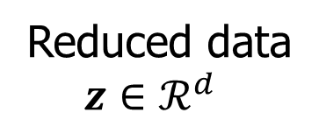
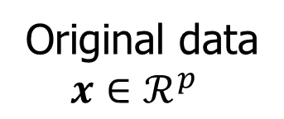
Linear Dimensionality Reduction
Linear transformation

Slide 28
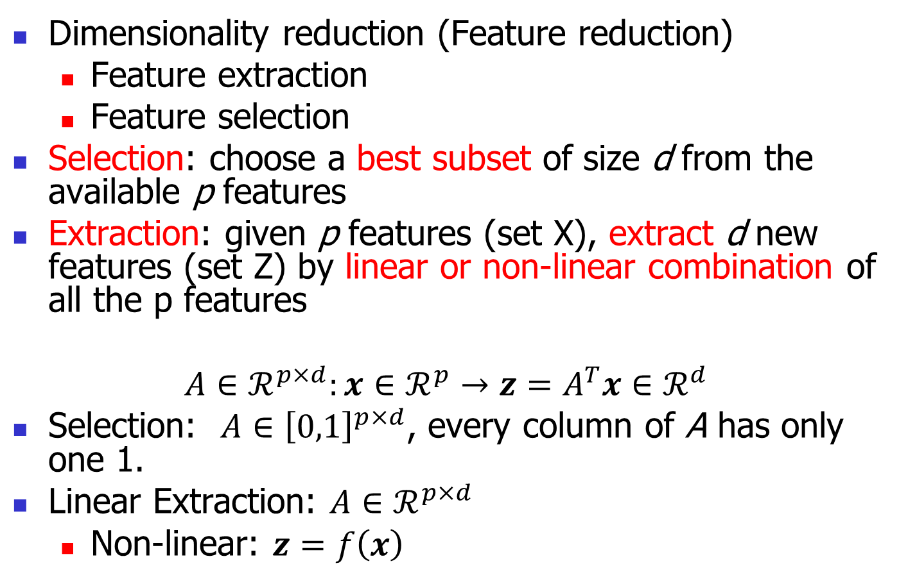
Feature Extraction vs Feature Selection
Dimensionality reduction (Feature reduction)
Feature extraction
Feature selection
Selection: choose a best subset of size d from the available p features
Extraction: given p features (set X), extract d new features (set Z) by linear or non-linear combination of all the p features
$$A∈ℛ^{p×d}:x∈ℛ^{p}→z=A^{T}x∈ℛ^{d}$$
Selection: $A∈{\left[0,1\right]}^{p×d}$, every column of A has only one 1.
Linear Extraction: $A∈ℛ^{p×d}$
Non-linear: $z=f\left(x\right)$

Slide 29
Principal Component Analysis (PCA)
Find a projection that captures the largest amount of variation in data
The original data are projected onto a much smaller space, resulting in dimensionality reduction. We find the eigenvectors of the covariance matrix, and these eigenvectors define the new space
x₂
e
x₁

Slide 30

Principal Component Analysis (PCA)

Slide 31
What is PCA?
Principal component analysis (PCA)
Reduce the dimensionality of a data set by finding a new set of variables, smaller than the original set of variables
Retains most of the sample's information.
Useful for the compression and classification of data.
By information we mean the variation present in the sample.
The new variables, called principal components (PCs), are uncorrelated, and are ordered by the fraction of the total information each retains.
Notes:
Covariance of two random variables = 0

Slide 32
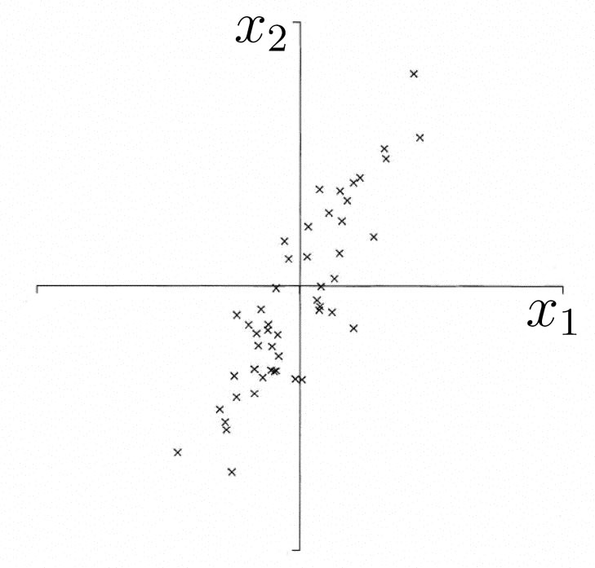
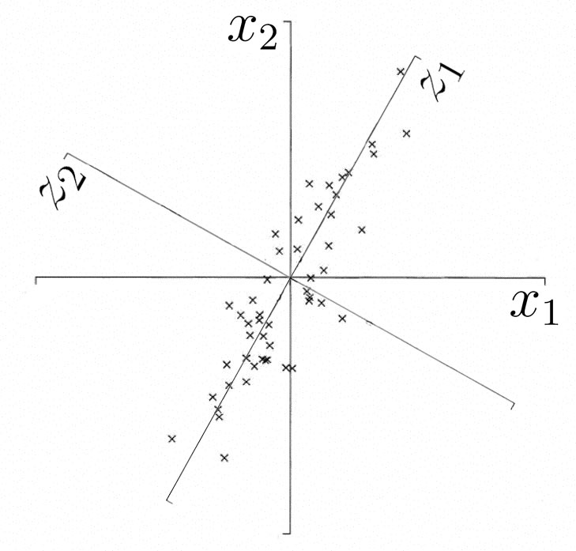
Geometric Picture of Principal Components (PCs)
The 1st PC z₁ is a minimum distance fit to a line in X space
The 2nd PC z₂ is a minimum distance fit to a line in the plane perpendicular to the 1st PC
PCs are a series of linear least squares fits to a line, each orthogonal to all the previous.

Slide 33
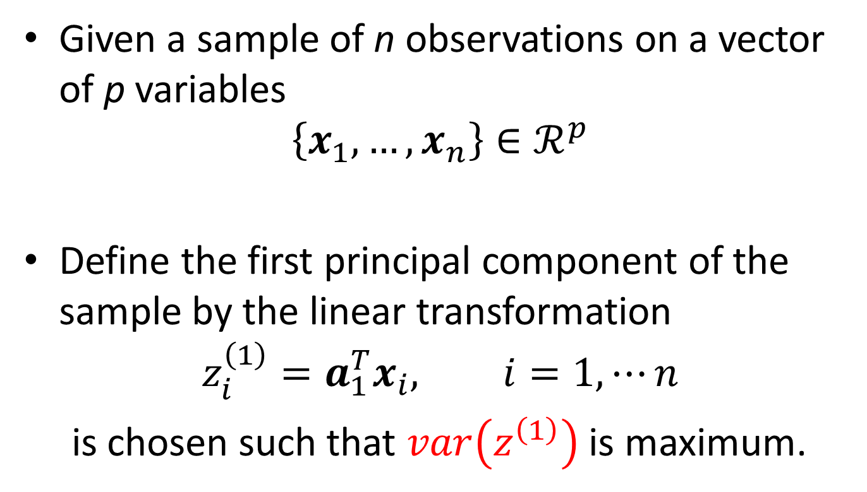
Algebraic Derivation of PCs
Given a sample of n observations on a vector of p variables
$$\left\{x_{1},…,x_{n}\right\}∈ℛ^{p}$$
Define the first principal component of the sample by the linear transformation
$$z_{i}^{\left(1\right)}=a_{1}^{T}x_{i}, i=1,⋯n$$
is chosen such that $var\left(z^{\left(1\right)}\right)$ is maximum.

Slide 34
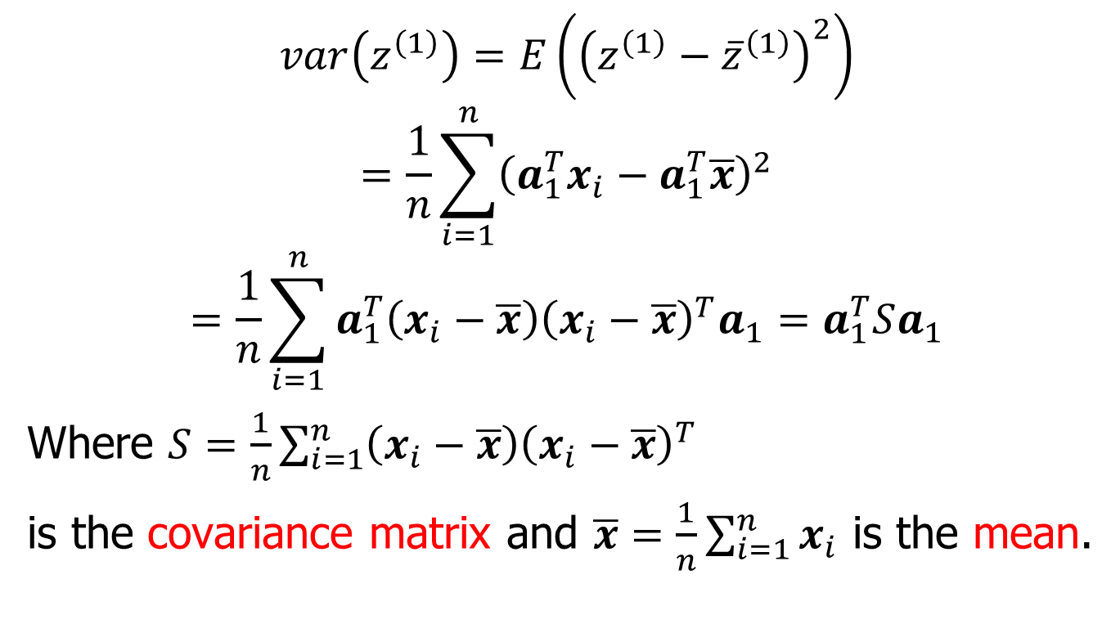
Algebraic Derivation of PCs
$$var\left(z^{\left(1\right)}\right)=E\left({\left(z^{\left(1\right)}−{\overline{z}}^{\left(1\right)}\right)}^{2}\right)$$
$$=\frac{1}{n}\sum_{i=1}^{n}{{\left(a_{1}^{T}x_{i}−a_{1}^{T}\overline{x}\right)}^{2}}$$
$$=\frac{1}{n}\sum_{i=1}^{n}{a_{1}^{T}\left(x_{i}−\overline{x}\right){\left(x_{i}−\overline{x}\right)}^{T}a_{1}}=a_{1}^{T}Sa_{1}$$
Where $S=\frac{1}{n}\sum_{i=1}^{n}{\left(x_{i}−\overline{x}\right){\left(x_{i}−\overline{x}\right)}^{T}}$
is the covariance matrix and $\overline{x}=\frac{1}{n}\sum_{i=1}^{n}{x_{i}}$ is the mean.

Slide 35
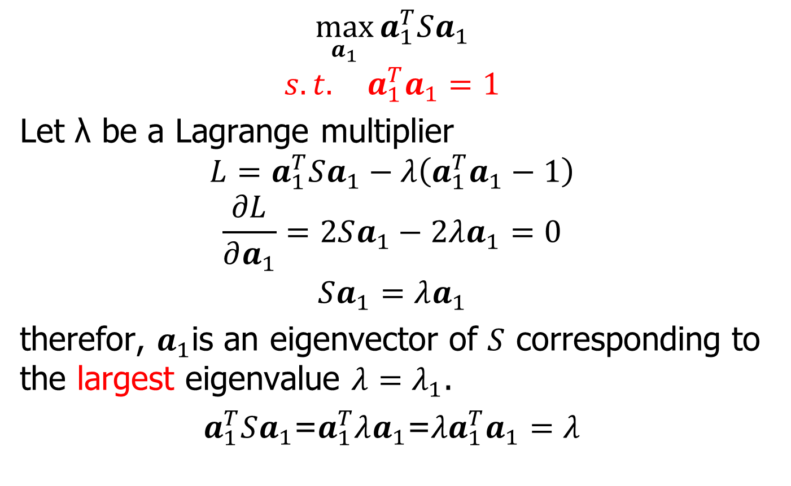
Algebraic Derivation of PCs
$$\max_{a_{1}}{a_{1}^{T}Sa_{1}}$$
$$s.t. a_{1}^{T}a_{1}=1$$
Let λ be a Lagrange multiplier
$$L=a_{1}^{T}Sa_{1}−λ\left(a_{1}^{T}a_{1}−1\right)$$
$$\frac{∂L}{∂a_{1}}=2Sa_{1}−2λa_{1}=0$$
$$Sa_{1}=λa_{1}$$
therefor, $a_{1}$is an eigenvector of $S$ corresponding to the largest eigenvalue $λ=λ_{1}$.
$a_{1}^{T}Sa_{1}$=$a_{1}^{T}λa_{1}\text{=}{λa}_{1}^{T}a_{1}=λ$

Slide 36
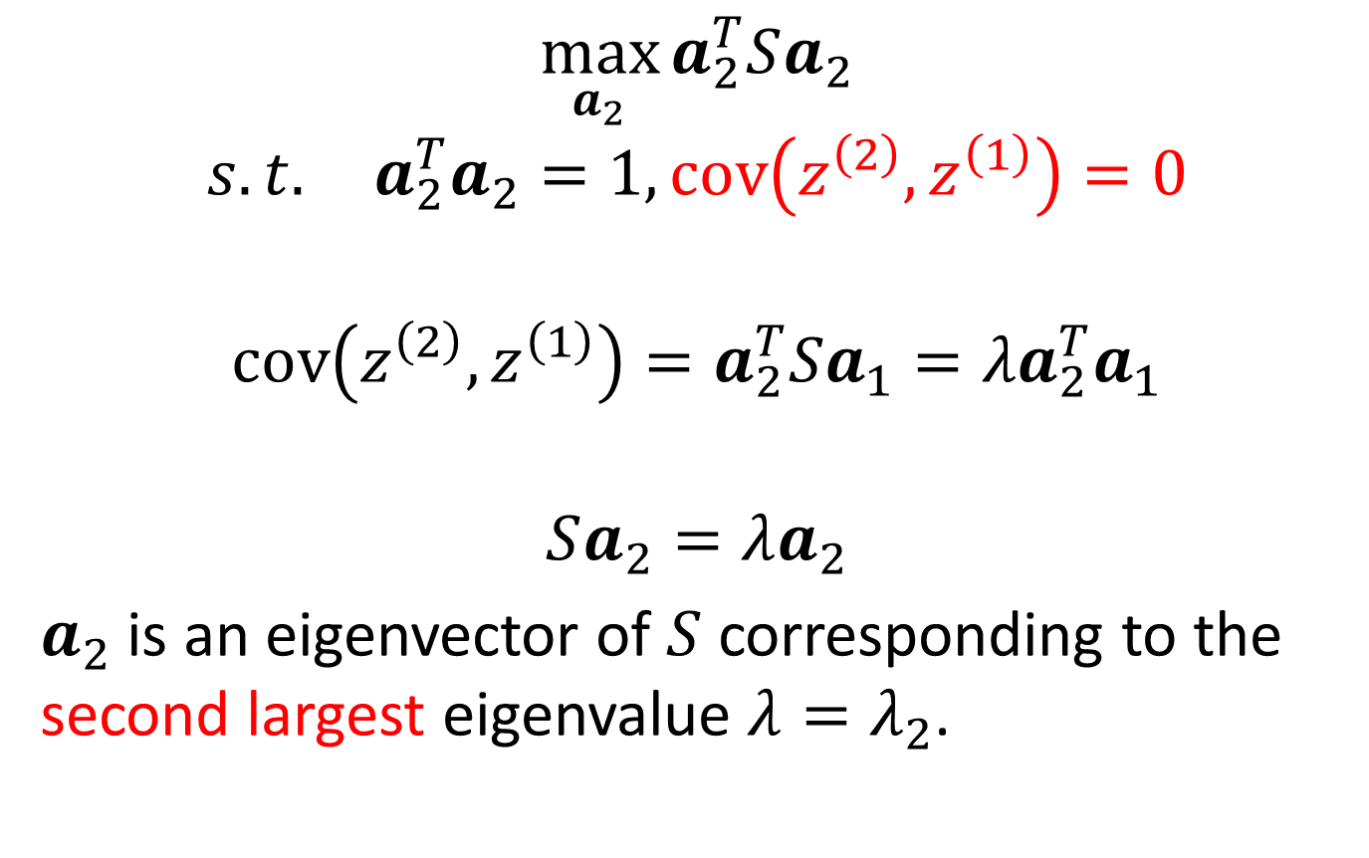
Algebraic Derivation of PCs
$$\max_{a_{2}}{a_{2}^{T}Sa_{2}}$$
$$s.t. a_{2}^{T}a_{2}=1, cov\left(z^{\left(2\right)},z^{\left(1\right)}\right)=0$$
$$cov\left(z^{\left(2\right)},z^{\left(1\right)}\right)=a_{2}^{T}Sa_{1}=λa_{2}^{T}a_{1}$$
$$Sa_{2}=λa_{2}$$
$a_{2}$ is an eigenvector of $S$ corresponding to the second largest eigenvalue $λ=λ_{2}$.
Notes:
Covariance

Slide 37
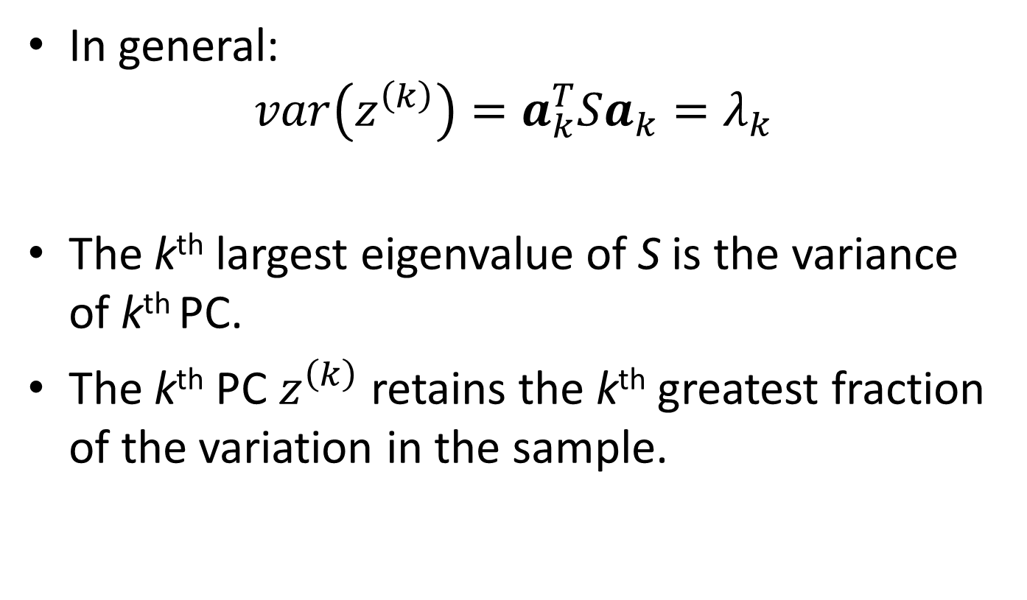
Algebraic Derivation of PCs
In general:
$$var\left(z^{\left(k\right)}\right)=a_{k}^{T}Sa_{k}=λ_{k}$$
The k^{th} largest eigenvalue of S is the variance of k^{th} PC.
The k^{th} PC $z^{\left(k\right)}$ retains the k^{th} greatest fraction of the variation in the sample.
Notes:
Covariance

Slide 38
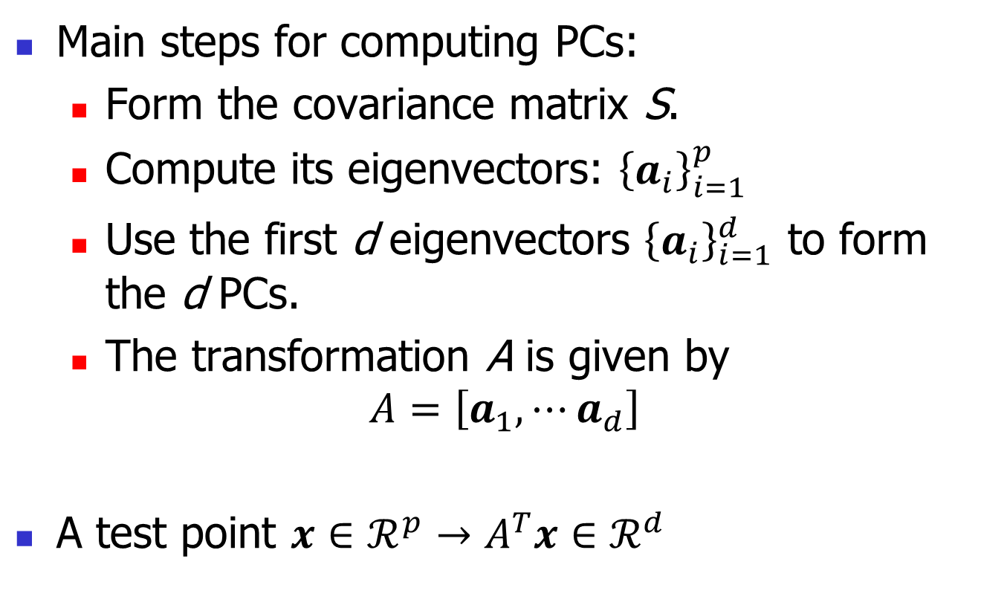
Principle Component Analysis
Main steps for computing PCs:
Form the covariance matrix S.
Compute its eigenvectors: ${\left\{a_{i}\right\}}_{i=1}^{p}$
Use the first d eigenvectors ${\left\{a_{i}\right\}}_{i=1}^{d}$ to form the d PCs.
The transformation A is given by
$$A=\left[a_{1},⋯a_{d}\right]$$
A test point $x∈ℛ^{p}→A^{T}x∈ℛ^{d}$
Notes:
Covariance

Slide 39
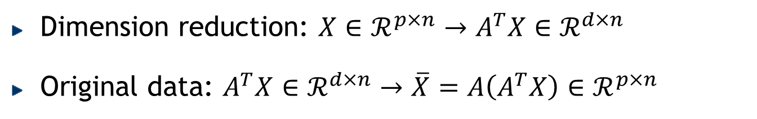
Optimality Property of PCA
Reconstruction
Dimension reduction: $X∈ℛ^{p×n}→A^{T}X∈ℛ^{d×n}$
Original data: $A^{T}X∈ℛ^{d×n}→\overline{X}=A\left(A^{T}X\right)∈ℛ^{p×n}$

Slide 40
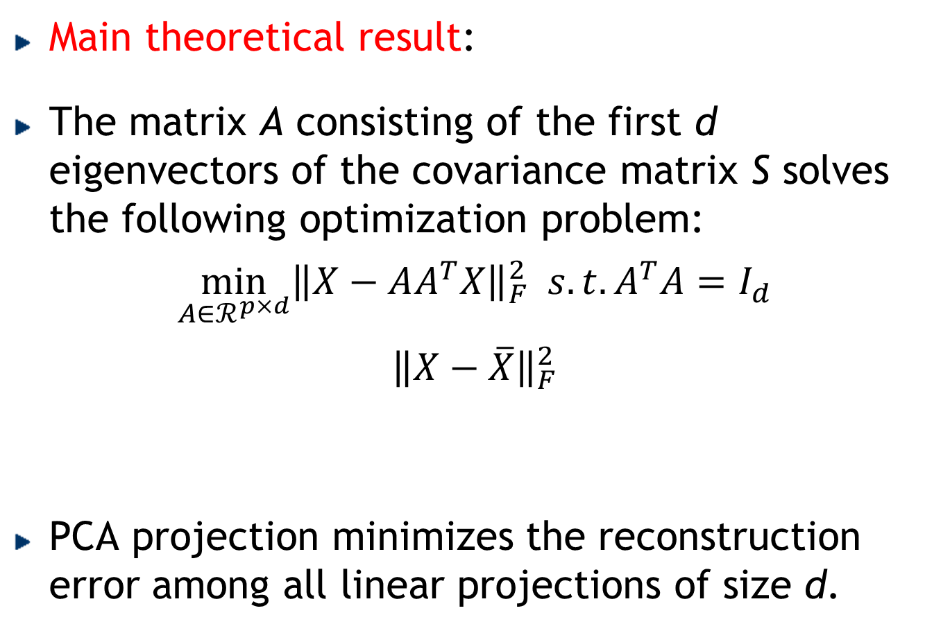
Optimality Property of PCA
Main theoretical result:
The matrix A consisting of the first d eigenvectors of the covariance matrix S solves the following optimization problem:
$$\min_{A∈ℛ^{p×d}}{{\left\|X−AA^{T}X\right\|}_{F}^{2} s.t. A^{T}A=I_{d}}$$
$${\left\|X−\overline{X}\right\|}_{F}^{2}$$
PCA projection minimizes the reconstruction error among all linear projections of size d.
Reconstruction error

Slide 41
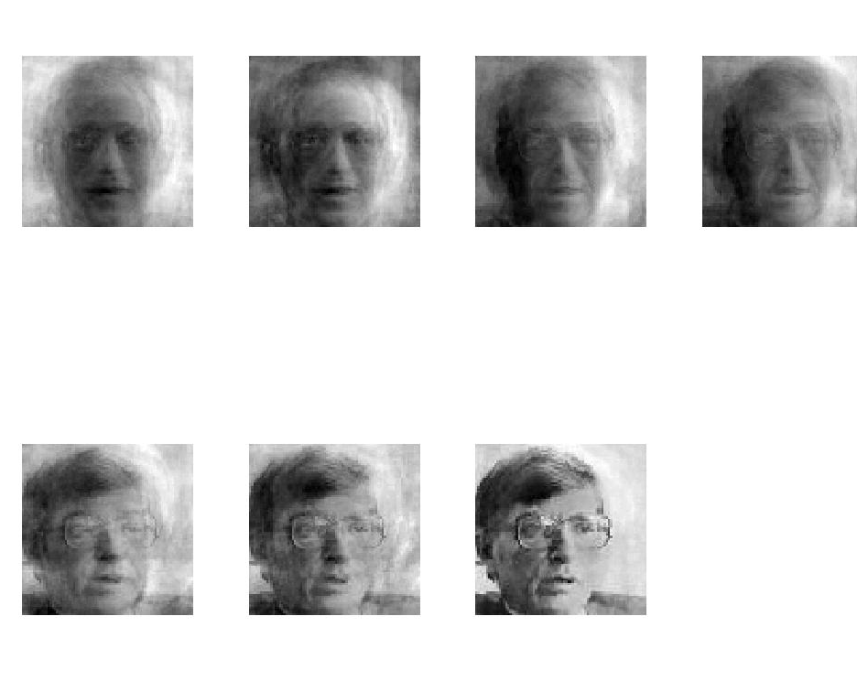
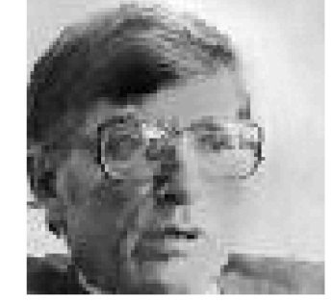
PCA for Image Compression
d=1
d=2
d=4
d=8
Original Image
d=16
d=32
d=64
d=100

Slide 42
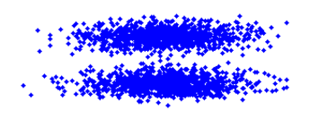
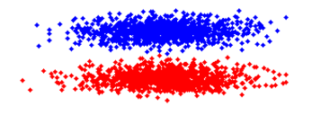
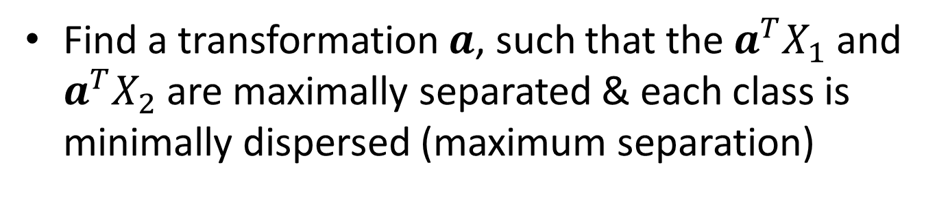
Linear Discriminant Analysis (Fisher Linear Discriminant)
Find a transformation $a$, such that the $a^{T}X_{1}$ and $a^{T}X_{2}$are maximally separated & each class is minimally dispersed (maximum separation)
Notes:
这里要讲下best separation的概念，类间最开和类内最聚都一样重要

Slide 43
Linear Discriminant Analysis
Perform dimensionality reduction “while preserving as much of the class discriminatory information as possible”.
Seeks to find directions along which the classes are best separated.
Takes into consideration the scatter within-classes but also the scatter between-classes.

Slide 44
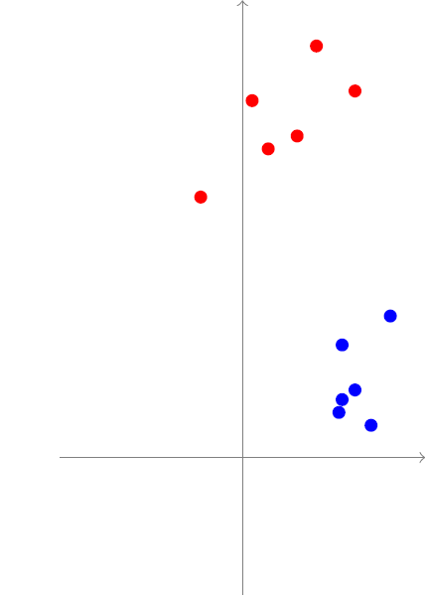
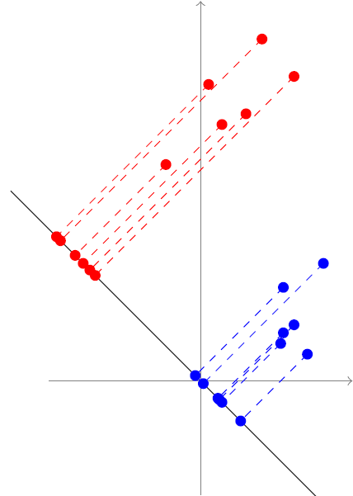
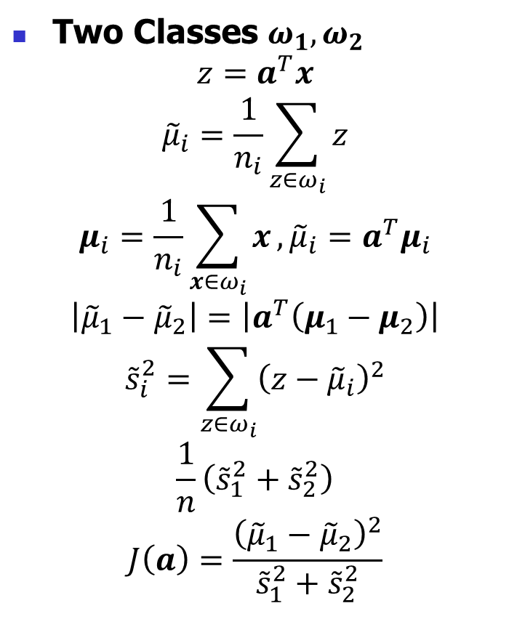
Linear Discriminant Analysis
Two Classes $ω_{1}, ω_{2}$
$$z=a^{T}x$$
$${\tilde{μ}}_{i}=\frac{1}{n_{i}}\sum_{z∈ω_{i}}{z}$$
$$μ_{i}=\frac{1}{n_{i}}\sum_{x∈ω_{i}}{x},{\tilde{μ}}_{i}=a^{T}μ_{i}$$
$$\left|{\tilde{μ}}_{1}−{\tilde{μ}}_{2}\right|=\left|a^{T}\left(μ_{1}−μ_{2}\right)\right|$$
$${\tilde{s}}_{i}^{2}=\sum_{z∈ω_{i}}{{\left(z−{\tilde{μ}}_{i}\right)}^{2}}$$
$$\frac{1}{n}\left({\tilde{s}}_{1}^{2}+{\tilde{s}}_{2}^{2}\right)$$
$$J\left(a\right)=\frac{{\left({\tilde{μ}}_{1}−{\tilde{μ}}_{2}\right)}^{2}}{{\tilde{s}}_{1}^{2}+{\tilde{s}}_{2}^{2}}$$
Notes:
Suppose that we have a set of n p-dimensional samples $x_{1},⋯x_{n}$, n₁ in the subset
D₁ labelled $ω_{1}$ and n₂ in the subset D₂ labelled $ω_{2}$.
Of course, to obtain good separation of the projected data we really want the difference
between the means to be large relative to some measure of the standard deviations for
each class. Rather than forming sample variances, we define the scatter for projected scatter
samples labelled $ω_{i}$ by

Slide 45



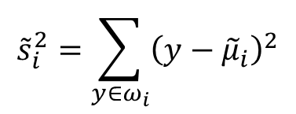
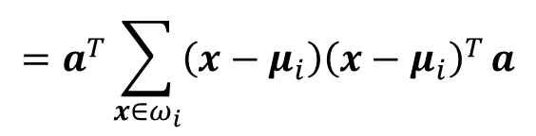


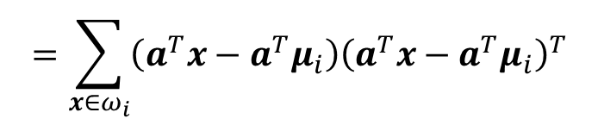

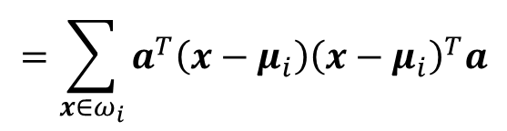


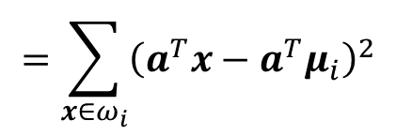


Linear Discriminant Analysis
$$J\left(a\right)=\frac{{\left({\tilde{μ}}_{1}−{\tilde{μ}}_{2}\right)}^{2}}{{\tilde{s}}_{1}^{2}+{\tilde{s}}_{2}^{2}}$$
$$=\frac{a^{T}S_{B}a}{a^{T}S_{W}a}$$
Two Classes
$${\tilde{s}}_{i}^{2}=\sum_{y∈ω_{i}}{{\left(y−{\tilde{μ}}_{i}\right)}^{2}}$$
$$=\sum_{x∈ω_{i}}{{\left(a^{T}x−a^{T}μ_{i}\right)}^{2}}$$
$$=\sum_{x∈ω_{i}}{\left(a^{T}x−a^{T}μ_{i}\right){\left(a^{T}x−a^{T}μ_{i}\right)}^{T}}$$
$$=\sum_{x∈ω_{i}}{a^{T}\left(x−μ_{i}\right){\left(x−μ_{i}\right)}^{T}a}$$
$$=a^{T}\sum_{x∈ω_{i}}{\left(x−μ_{i}\right){\left(x−μ_{i}\right)}^{T}}a$$
$$=a^{T}S_{i}a$$
$S_{i}$: scatter matrix
within-class scatter matrix: $S_{W}=S_{1}+S_{2}$
$${\tilde{s}}_{1}^{2}+{\tilde{s}}_{2}^{2}=a^{T}S_{W}a$$
$${\left({\tilde{μ}}_{1}−{\tilde{μ}}_{2}\right)}^{2}$$
$$={\left(a^{T}μ_{1}−a^{T}μ_{2}\right)}^{2}$$
$$=a^{T}\left(μ_{1}−μ_{2}\right){\left(μ_{1}−μ_{2}\right)}^{T}a$$
$$=a^{T}S_{B}a$$
between-class scatter matrix: $S_{B}=\left(μ_{1}−μ_{2}\right){\left(μ_{1}−μ_{2}\right)}^{T}$
Notes:
S_{W} is called the within-class scatter matrix.
It is proportional to the sample covariance matrix for the pooled p-dimensional data
It is symmetric and positive semi-definite, and is usually nonsingular if n > p
S_{B} is called the between-class scatter matrix.
It is also symmetric and positive semi-definite,
but because it is the outer product of two vectors, its rank is at most one.

Slide 46



Linear Discriminant Analysis
$$J\left(a\right)=\frac{a^{T}S_{B}a}{a^{T}S_{W}a}$$
Two Classes
$$S_{B}a=λS_{W}a$$
? Homework
$$a^{∗}=S_{W}^{−1}\left(μ_{1}−μ_{2}\right)$$
Notes:
All that remains is to find the threshold, i.e., the point along the one-dimensional subspace separating the projected points.
不妨设分母为1，则优化目标变成了max分子，st分母为1。再使用拉格朗日即可得到
我们只关心a的方向，不关心a的大小，因此所有的常数项或者标量项都可以忽略

Slide 47
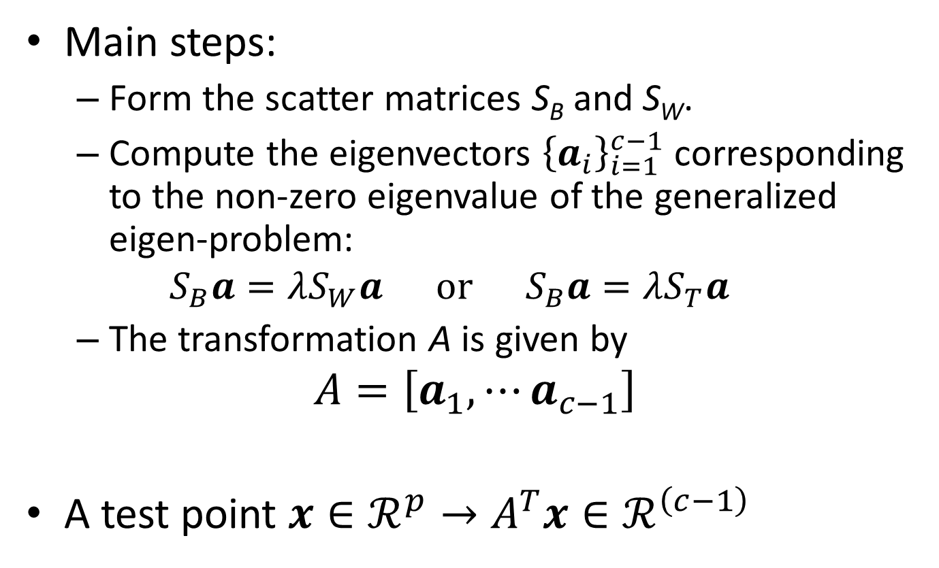
Linear Discriminant Analysis
Main steps:
Form the scatter matrices S_{B} and S_{W}.
Compute the eigenvectors ${\left\{a_{i}\right\}}_{i=1}^{c−1}$ corresponding to the non-zero eigenvalue of the generalized eigen-problem:
$$S_{B}a=λS_{W}a or S_{B}a=λS_{T}a$$
The transformation A is given by
$$A=\left[a_{1},⋯a_{c−1}\right]$$
A test point $x∈ℛ^{p}→A^{T}x∈ℛ^{\left(c−1\right)}$
Notes:
S_{W} S_{T} non-singular

Slide 48
Attribute Subset Selection
Another way to reduce dimensionality of data
Redundant attributes
Duplicate much or all of the information contained in one or more other attributes
E.g., purchase price of a product and the amount of sales tax paid
Irrelevant attributes
Contain no information that is useful for the data mining task at hand
E.g., students' ID is often irrelevant to the task of predicting students' GPA

Slide 49
Heuristic Search in Attribute Selection
There are 2^{d} possible attribute combinations of d attributes
Typical heuristic attribute selection methods:
Best single attribute under the attribute independence assumption: choose by significance tests
Best step-wise feature selection:
The best single-attribute is picked first
Then next best attribute condition to the first, ...
Step-wise attribute elimination:
Repeatedly eliminate the worst attribute
Best combined attribute selection and elimination
Optimal branch and bound:
Use attribute elimination and backtracking

Slide 50
Attribute Creation (Feature Generation)
50
Create new attributes (features) that can capture the important information in a data set more effectively than the original ones
Three general methodologies
Attribute extraction
Domain-specific
Mapping data to new space (see: data reduction)
E.g., Fourier transformation, wavelet transformation, manifold approaches (not covered)
Attribute construction
Combining features (see: discriminative frequent patterns in Chapter 7)
Data discretization
Notes:
50

Slide 51
Data Reduction 2: Numerosity Reduction
Reduce data volume by choosing alternative, smaller forms of data representation
Parametric methods (e.g., regression)
Assume the data fits some model, estimate model parameters, store only the parameters, and discard the data (except possible outliers)
Ex.: Log-linear models—obtain value at a point in m-D space as the product on appropriate marginal subspaces
Non-parametric methods
Do not assume models
Major families: histograms, clustering, sampling, …

Slide 52
Parametric Data Reduction: Regression and Log-Linear Models
Linear regression
Data modeled to fit a straight line
Often uses the least-square method to fit the line
Multiple regression
Allows a response variable Y to be modeled as a linear function of multidimensional feature vector
Log-linear model
Approximates discrete multidimensional probability distributions

Slide 53
Regression Analysis
y
Y1
Regression analysis: A collective name for techniques for the modeling and analysis of numerical data consisting of values of a dependent variable (also called response variable or measurement) and of one or more independent variables (aka. explanatory variables or predictors)
The parameters are estimated so as to give a "best fit" of the data
Most commonly the best fit is evaluated by using the least squares method, but other criteria have also been used
Y1’
y = x + 1
X1
x
Used for prediction (including forecasting of time-series data), inference, hypothesis testing, and modeling of causal relationships

Slide 54
Regress Analysis and Log-Linear Models
Linear regression: Y = w X + b
Two regression coefficients, w and b, specify the line and are to be estimated by using the data at hand
Using the least squares criterion to the known values of Y₁, Y₂, …, X₁, X₂, ….
Multiple regression: Y = b₀ + b₁ X₁ + b₂ X₂
Many nonlinear functions can be transformed into the above
Log-linear models:
Approximate discrete multidimensional probability distributions
Estimate the probability of each point (tuple) in a multi-dimensional space for a set of discretized attributes, based on a smaller subset of dimensional combinations
Useful for dimensionality reduction and data smoothing

Slide 55
Histogram Analysis
Divide data into buckets and store average (sum) for each bucket
Partitioning rules:
Equal-width: equal bucket range
Equal-frequency (or equal-depth)

Slide 56
Clustering
Partition data set into clusters based on similarity, and store cluster representation (e.g., centroid and diameter) only
Can be very effective if data is clustered but not if data is “smeared”
Can have hierarchical clustering and be stored in multi-dimensional index tree structures
There are many choices of clustering definitions and clustering algorithms
Cluster analysis will be studied in depth in Chapter 10

Slide 57
Sampling
Sampling: obtaining a small sample s to represent the whole data set N
Allow a mining algorithm to run in complexity that is potentially sub-linear to the size of the data
Key principle: Choose a representative subset of the data
Simple random sampling may have very poor performance in the presence of skew
Develop adaptive sampling methods, e.g., stratified sampling:
Note: Sampling may not reduce database I/Os (page at a time)

Slide 58
Types of Sampling
Simple random sampling
There is an equal probability of selecting any particular item
Sampling without replacement
Once an object is selected, it is removed from the population
Sampling with replacement
A selected object is not removed from the population
Stratified sampling:
Partition the data set, and draw samples from each partition (proportionally, i.e., approximately the same percentage of the data)
Used in conjunction with skewed data

Slide 59
Sampling: With or without Replacement
SRSWOR
(simple random
sample without
replacement)
SRSWR
Raw Data

Slide 60
Sampling: Cluster or Stratified Sampling
Raw Data
Cluster/Stratified Sample

Slide 61
Data Cube Aggregation
The lowest level of a data cube (base cuboid)
The aggregated data for an individual entity of interest
E.g., a customer in a phone calling data warehouse
Multiple levels of aggregation in data cubes
Further reduce the size of data to deal with
Reference appropriate levels
Use the smallest representation which is enough to solve the task
Queries regarding aggregated information should be answered using data cube, when possible
Notes:
61

Slide 62
Data Reduction 3: Data Compression
String compression
There are extensive theories and well-tuned algorithms
Typically lossless, but only limited manipulation is possible without expansion
Audio/video compression
Typically lossy compression, with progressive refinement
Sometimes small fragments of signal can be reconstructed without reconstructing the whole
Time sequence is not audio
Typically short and vary slowly with time
Dimensionality and numerosity reduction may also be considered as forms of data compression
Notes:
62

Slide 63
Data Compression
Original Data
Compressed
Data
lossless
Original Data
Approximated
lossy
Notes:
63

Slide 64
Chapter 3: Data Preprocessing
Data Preprocessing: An Overview
Data Quality
Major Tasks in Data Preprocessing
Data Cleaning
Data Integration
Data Reduction
Data Transformation and Data Discretization
Summary
Notes:
64

Slide 65
Data Transformation
A function that maps the entire set of values of a given attribute to a new set of replacement values s.t. each old value can be identified with one of the new values
Methods
Smoothing: Remove noise from data
Attribute/feature construction
New attributes constructed from the given ones
Aggregation: Summarization, data cube construction
Normalization: Scaled to fall within a smaller, specified range
min-max normalization
z-score normalization
normalization by decimal scaling
Discretization: Concept hierarchy climbing
Notes:
65

Slide 66
Normalization
Min-max normalization: to [new_min_{A}, new_max_{A}]
Ex. Let income range $12,000 to $98,000 normalized to [0.0, 1.0]. Then $73,000 is mapped to
Z-score normalization (μ: mean, σ: standard deviation):
Ex. Let μ = 54,000, σ = 16,000. Then
Normalization by decimal scaling
Where j is the smallest integer such that Max(|ν’|) < 1

Slide 67
Discretization
Three types of attributes
Nominal—values from an unordered set, e.g., color, profession
Ordinal—values from an ordered set, e.g., military or academic rank
Numeric—real numbers, e.g., integer or real numbers
Discretization: Divide the range of a continuous attribute into intervals
Interval labels can then be used to replace actual data values
Reduce data size by discretization
Supervised vs. unsupervised
Split (top-down) vs. merge (bottom-up)
Discretization can be performed recursively on an attribute
Prepare for further analysis, e.g., classification

Slide 68
Data Discretization Methods
Typical methods: All the methods can be applied recursively
Binning
Top-down split, unsupervised
Histogram analysis
Top-down split, unsupervised
Clustering analysis (unsupervised, top-down split or bottom-up merge)
Decision-tree analysis (supervised, top-down split)
Correlation (e.g., χ²) analysis (unsupervised, bottom-up merge)
68
Notes:
68

Slide 69
Simple Discretization: Binning
Equal-width (distance) partitioning
Divides the range into N intervals of equal size: uniform grid
if A and B are the lowest and highest values of the attribute, the width of intervals will be: W = (B –A)/N.
The most straightforward, but outliers may dominate presentation
Skewed data is not handled well
Equal-depth (frequency) partitioning
Divides the range into N intervals, each containing approximately same number of samples
Good data scaling
Managing categorical attributes can be tricky

Slide 70
Binning Methods for Data Smoothing
Sorted data for price (in dollars): 4, 8, 9, 15, 21, 21, 24, 25, 26, 28, 29, 34
* Partition into equal-frequency (equi-depth) bins:
- Bin 1: 4, 8, 9, 15
- Bin 2: 21, 21, 24, 25
- Bin 3: 26, 28, 29, 34
* Smoothing by bin means:
- Bin 1: 9, 9, 9, 9
- Bin 2: 23, 23, 23, 23
- Bin 3: 29, 29, 29, 29
* Smoothing by bin boundaries:
- Bin 1: 4, 4, 4, 15
- Bin 2: 21, 21, 25, 25
- Bin 3: 26, 26, 26, 34

Slide 71
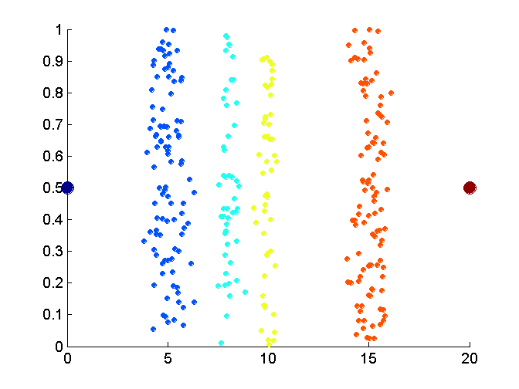
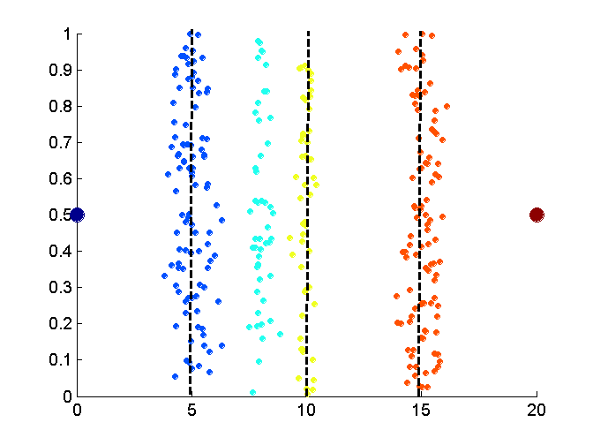
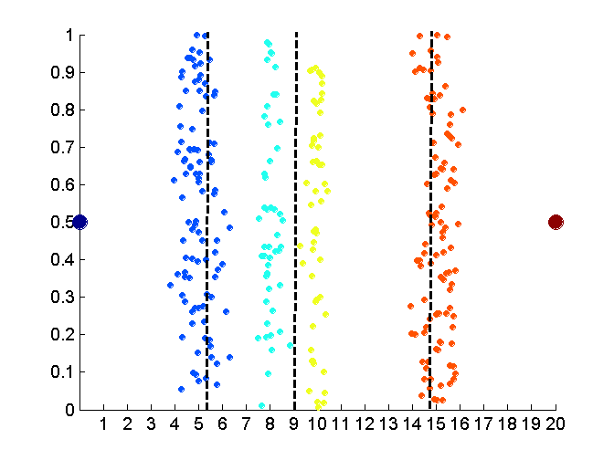
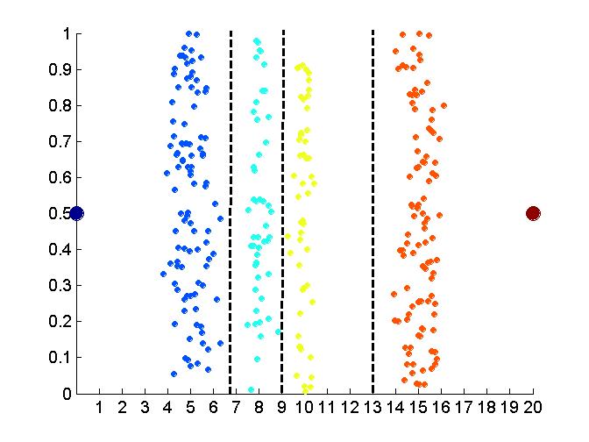
Discretization Without Using Class Labels (Binning vs. Clustering)
Data
Equal interval width (binning)
Equal frequency (binning)
K-means clustering leads to better results
71
Notes:
71

Slide 72
Discretization by Classification & Correlation Analysis
Classification (e.g., decision tree analysis)
Supervised: Given class labels, e.g., cancerous vs. benign
Using entropy to determine split point (discretization point)
Top-down, recursive split
Details to be covered in Chapter 7
Correlation analysis (e.g., Chi-merge: χ²-based discretization)
Supervised: use class information
Bottom-up merge: find the best neighboring intervals (those having similar distributions of classes, i.e., low χ² values) to merge
Merge performed recursively, until a predefined stopping condition
72
Notes:
72

Slide 73
Concept Hierarchy Generation
Concept hierarchy organizes concepts (i.e., attribute values) hierarchically and is usually associated with each dimension in a data warehouse
Concept hierarchies facilitate drilling and rolling in data warehouses to view data in multiple granularity
Concept hierarchy formation: Recursively reduce the data by collecting and replacing low level concepts (such as numeric values for age) by higher level concepts (such as youth, adult, or senior)
Concept hierarchies can be explicitly specified by domain experts and/or data warehouse designers
Concept hierarchy can be automatically formed for both numeric and nominal data. For numeric data, use discretization methods shown.

Slide 74
Concept Hierarchy Generation for Nominal Data
Specification of a partial/total ordering of attributes explicitly at the schema level by users or experts
street < city < state < country
Specification of a hierarchy for a set of values by explicit data grouping
{Urbana, Champaign, Chicago} < Illinois
Specification of only a partial set of attributes
E.g., only street < city, not others
Automatic generation of hierarchies (or attribute levels) by the analysis of the number of distinct values
E.g., for a set of attributes: {street, city, state, country}

Slide 75
Automatic Concept Hierarchy Generation
Some hierarchies can be automatically generated based on the analysis of the number of distinct values per attribute in the data set
The attribute with the most distinct values is placed at the lowest level of the hierarchy
Exceptions, e.g., weekday, month, quarter, year
country
15 distinct values
province_or_ state
365 distinct values
city
3567 distinct values
street
674,339 distinct values

Slide 76
Chapter 3: Data Preprocessing
Data Preprocessing: An Overview
Data Quality
Major Tasks in Data Preprocessing
Data Cleaning
Data Integration
Data Reduction
Data Transformation and Data Discretization
Summary
Notes:
76

Slide 77
Summary
Data quality: accuracy, completeness, consistency, timeliness, believability, interpretability
Data cleaning: e.g. missing/noisy values, outliers
Data integration from multiple sources:
Entity identification problem
Remove redundancies
Detect inconsistencies
Data reduction
Dimensionality reduction
Numerosity reduction
Data compression
Data transformation and data discretization
Normalization
Concept hierarchy generation

Slide 78
References
D. P. Ballou and G. K. Tayi. Enhancing data quality in data warehouse environments. Comm. of ACM, 42:73-78, 1999
A. Bruce, D. Donoho, and H.-Y. Gao. Wavelet analysis. IEEE Spectrum, Oct 1996
T. Dasu and T. Johnson. Exploratory Data Mining and Data Cleaning. John Wiley, 2003
J. Devore and R. Peck. Statistics: The Exploration and Analysis of Data. Duxbury Press, 1997.
H. Galhardas, D. Florescu, D. Shasha, E. Simon, and C.-A. Saita. Declarative data cleaning: Language, model, and algorithms. VLDB'01
M. Hua and J. Pei. Cleaning disguised missing data: A heuristic approach. KDD'07
H. V. Jagadish, et al., Special Issue on Data Reduction Techniques. Bulletin of the Technical Committee on Data Engineering, 20(4), Dec. 1997
H. Liu and H. Motoda (eds.). Feature Extraction, Construction, and Selection: A Data Mining Perspective. Kluwer Academic, 1998
J. E. Olson. Data Quality: The Accuracy Dimension. Morgan Kaufmann, 2003
D. Pyle. Data Preparation for Data Mining. Morgan Kaufmann, 1999
V. Raman and J. Hellerstein. Potters Wheel: An Interactive Framework for Data Cleaning and Transformation, VLDB’2001
T. Redman. Data Quality: The Field Guide. Digital Press (Elsevier), 2001
R. Wang, V. Storey, and C. Firth. A framework for analysis of data quality research. IEEE Trans. Knowledge and Data Engineering, 7:623-640, 1995

